Slide 1
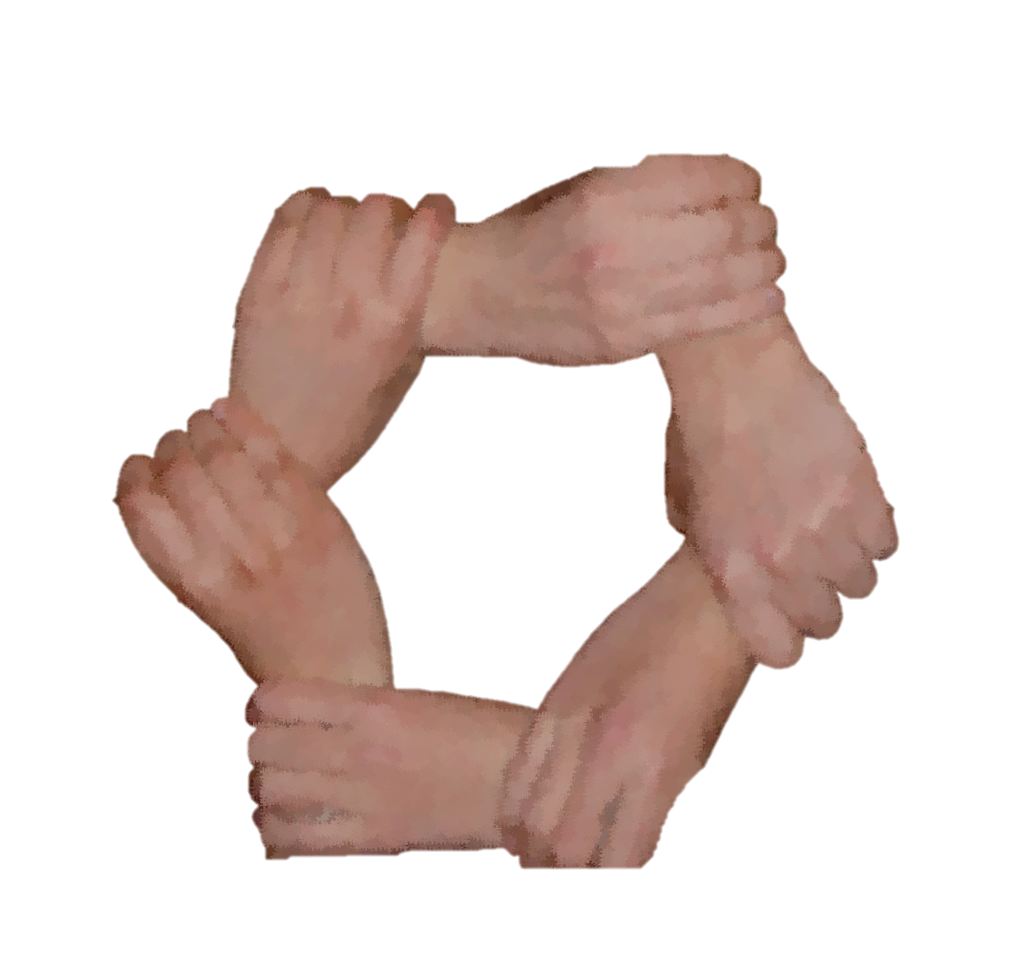
BOCC Security & Safety Team Seeking new members MALE & FEMALE TO ENSURE THE SAFETY OF OUR CHURCH
bbulow@att.net
Contact: Deacon Brian Bulow
Notes:
Sign up Sheet will be in the Welcome Center

Slide 2
VOLUNTEER INTEREST MEETING ( and brief overview)
Create slides displayed on projectors (includes announcements, Sermons etc.)
Control audio in the sanctuary and on live stream
Upload song lyrics, announcements and other graphics to presentation software.
Control lighting and other stage effects
Manage streaming software for live video feed to YouTube & Facebook.
Camera operations (setup, takedown and storage)
Saturday August 26th @ Noon in the Sanctuary
Contacts:
Calvin Meekins - cdmeekins27@gmail.com
Reggie Perry - rperry@bodyofchristchurch.org
Notes:
Have a heart to serve? Looking for a ministry to join? We are seeking new volunteers.
Holding an interest meeting and brief overview of what we do and how you can help.

